Slide 1

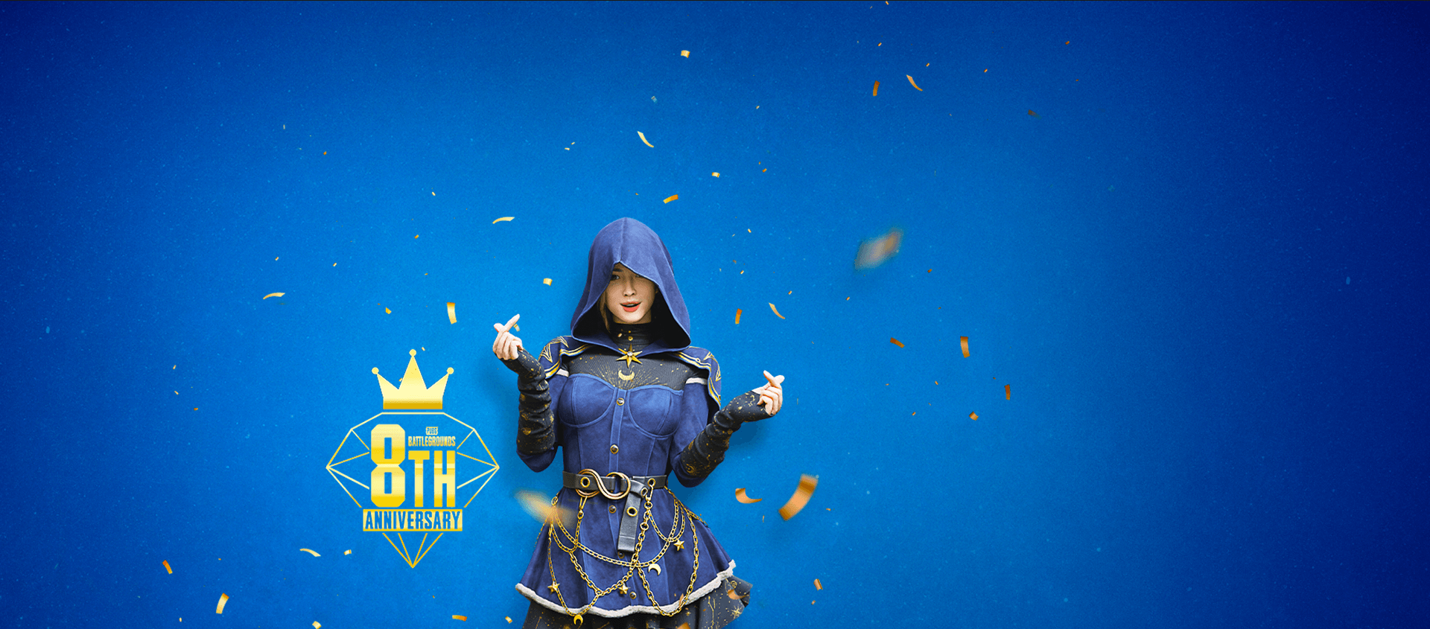

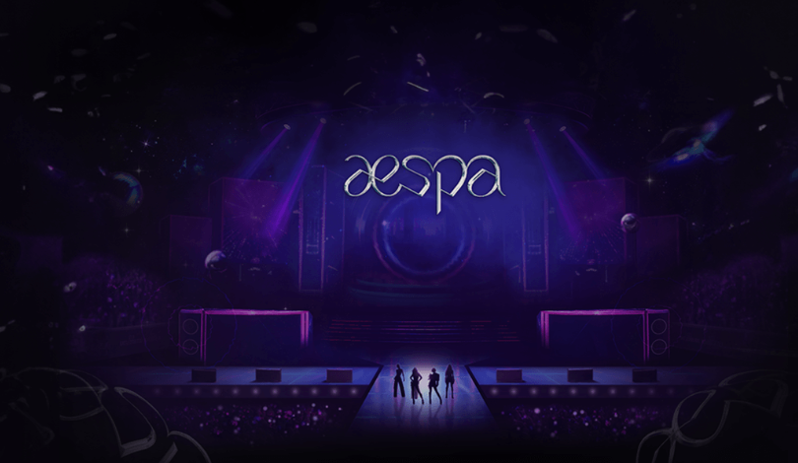
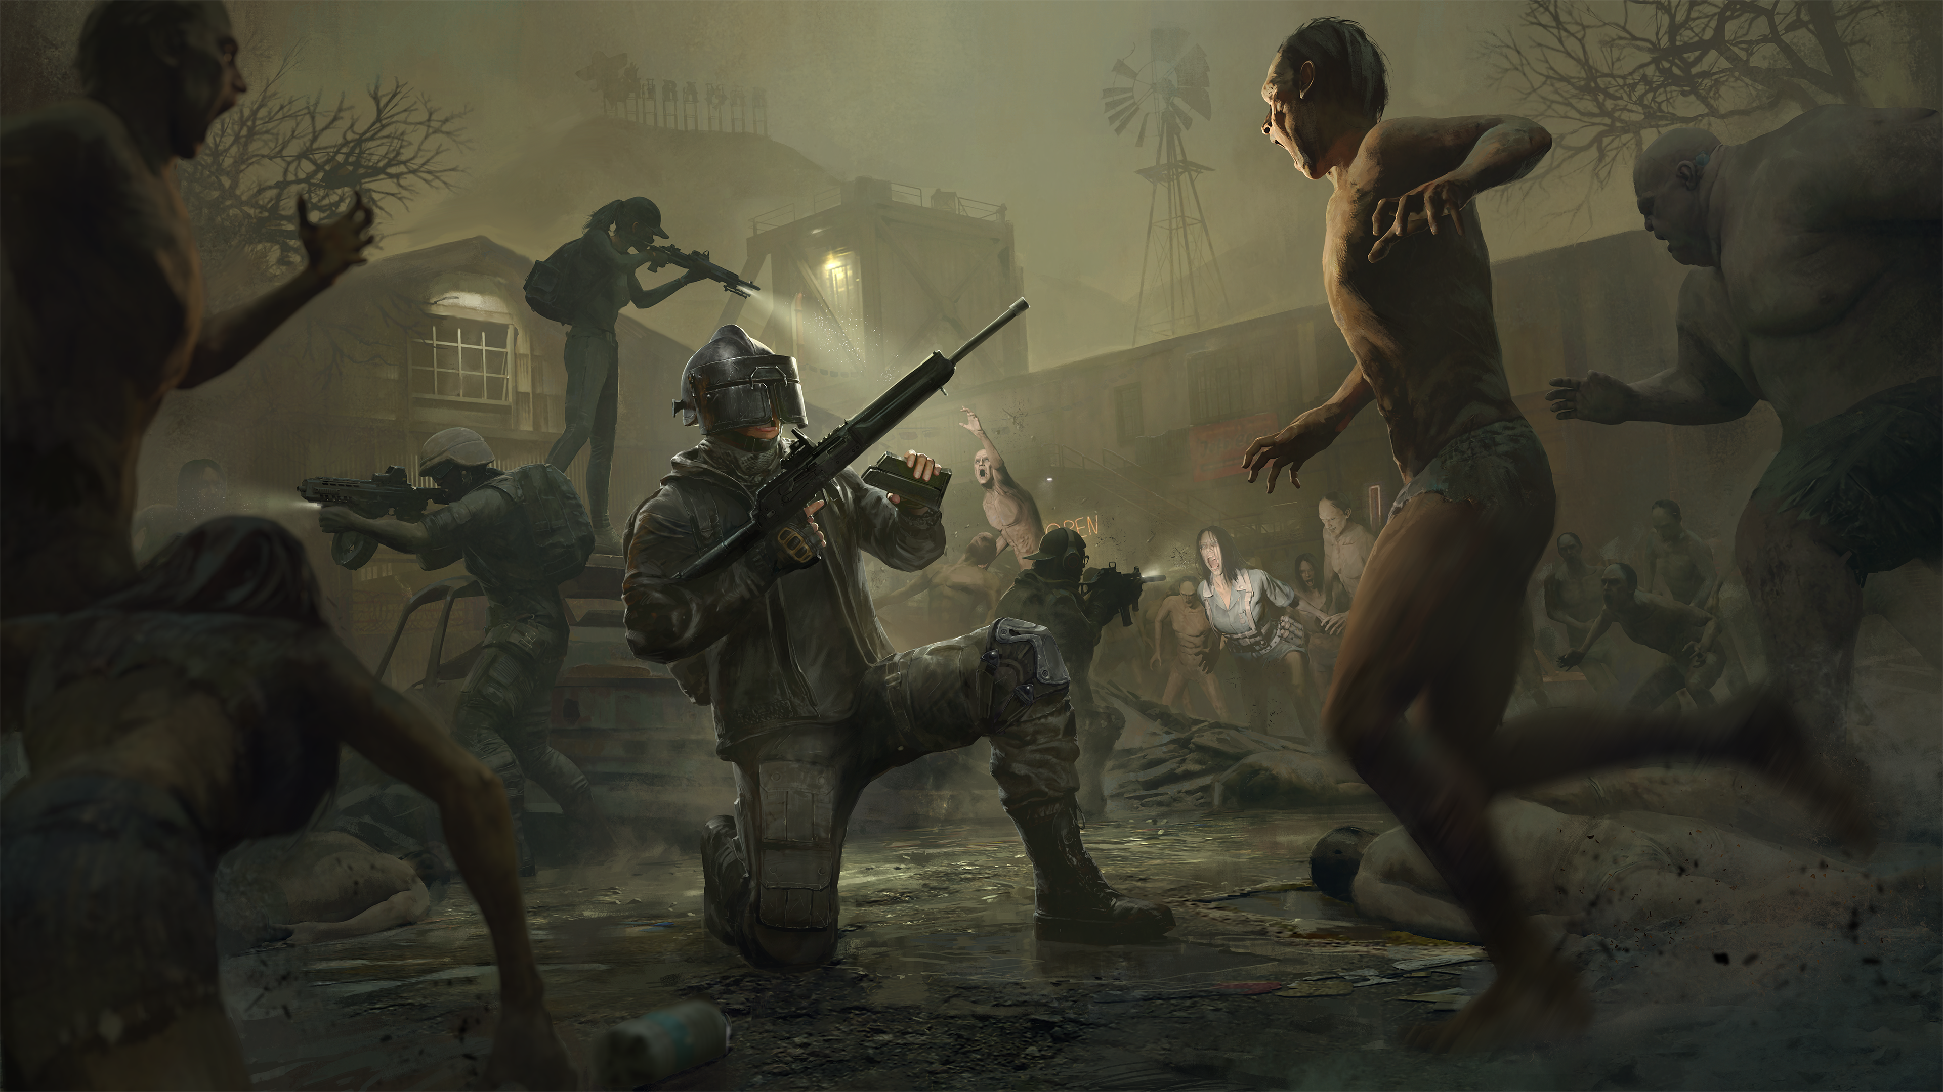


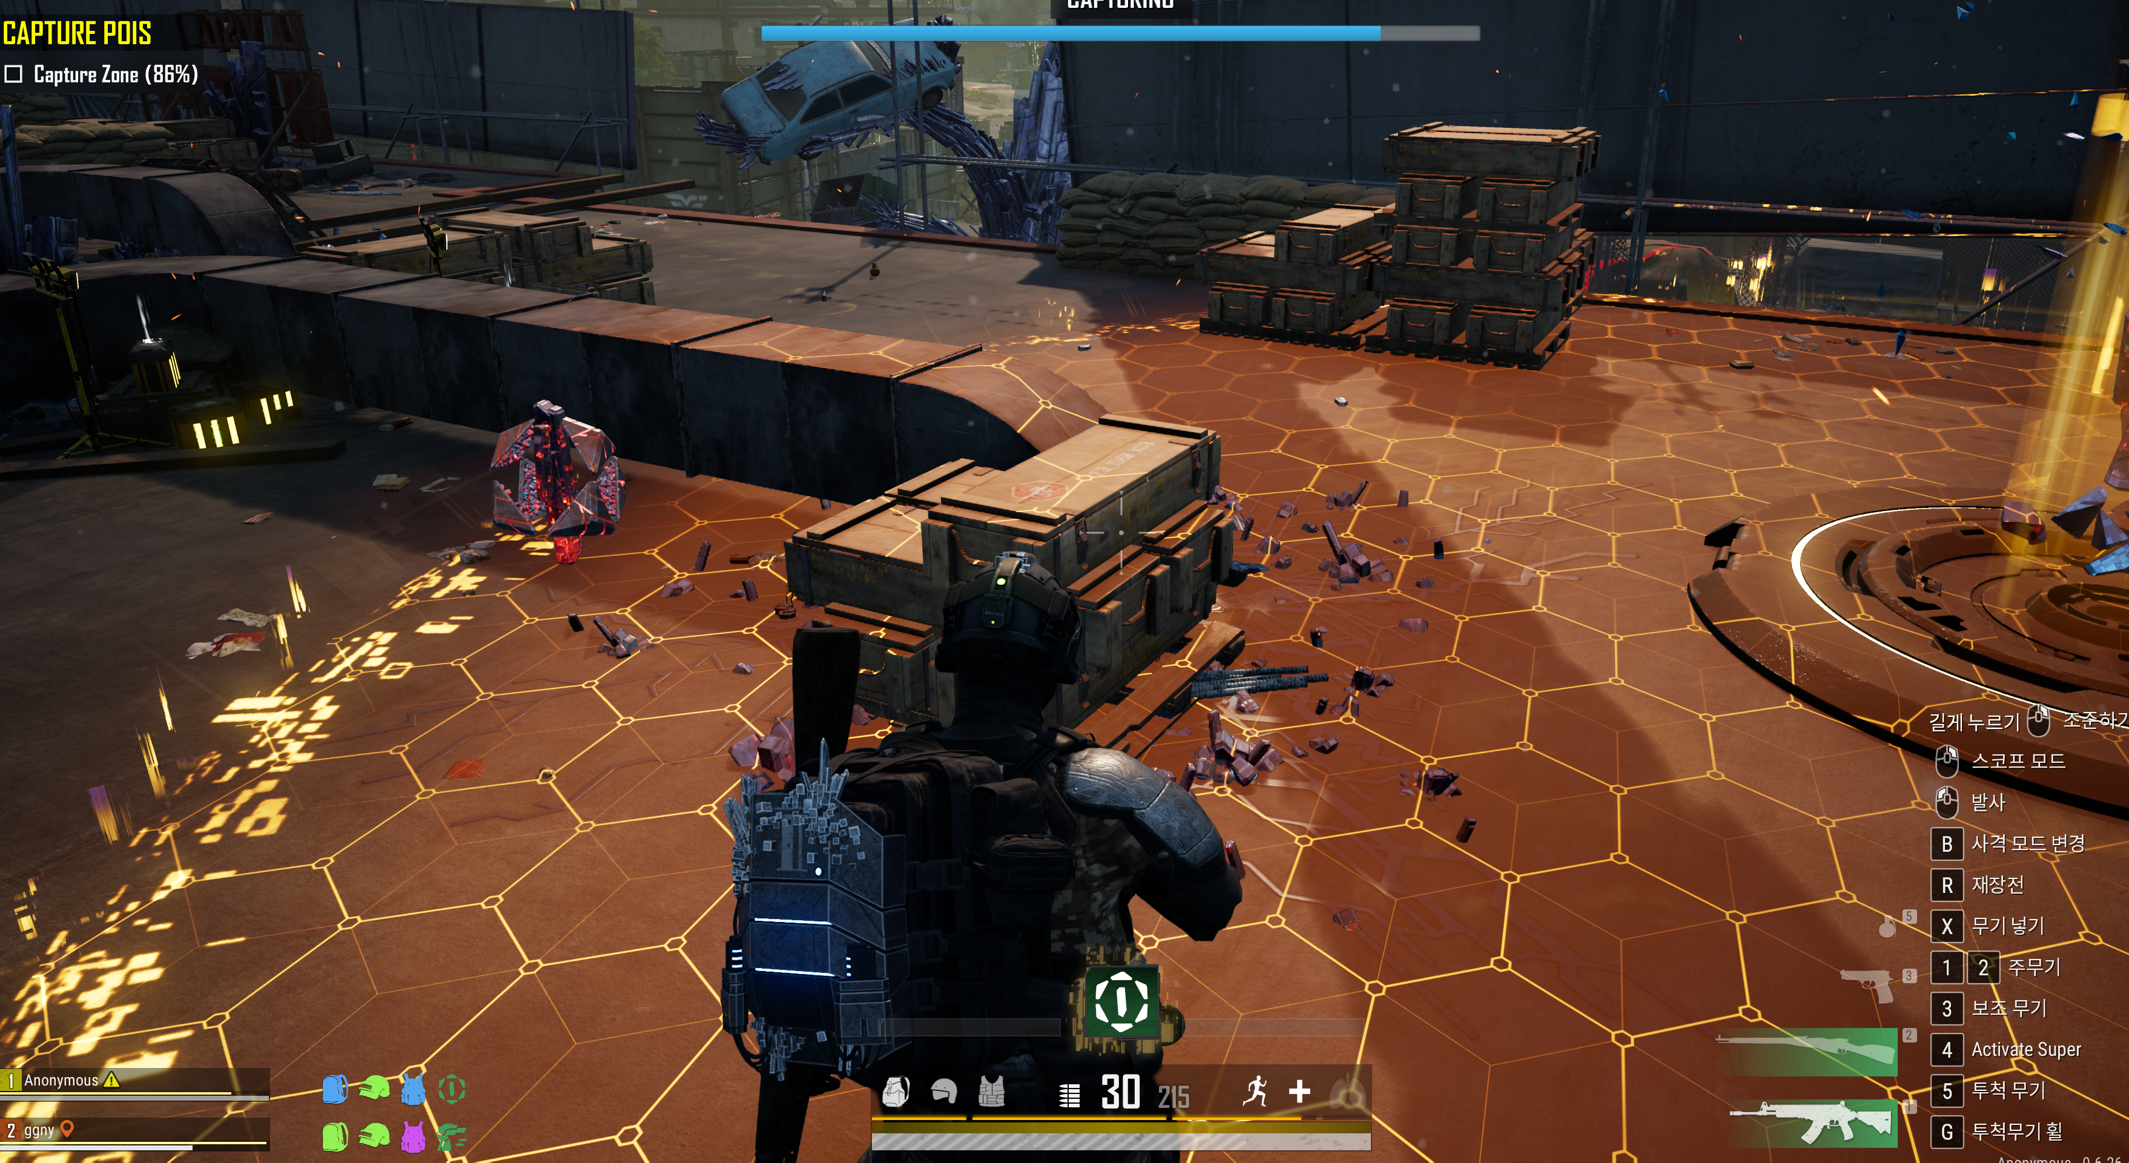

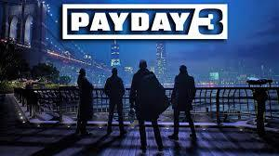
PUBG PC/Console 2026 Roadmap: h. 2026 User Incentive Strategy & Operations
2026 Event Direction
Scale-up of events based on rewards and content expansion to maximize peak-season traffic and stabilize the off-season
Response methods
Primary target seasons
2026 Event Direction
Peak season
1Q (Lunar New Year, Nth Anniversary, to April Fools' Day)
Seasonality-based promotion scale-up
Expand event scale based on existing main seasons and key updates
March Nth Anniversary, July–August Summer Vacation, September Chuseok/Mid-Autumn Festival, December Large-scale World Update
Beyond simple rewards and OES expansion, linked with exposure- and participation-oriented actions
For example) content to drive streamer events, social challenges, esports event teasers and on-site event prompts
Increase scale to attract interest from returning existing users and new users
Strengthen familiar fun for existing/returning users and provide re-engagement incentives
Provide fresh entry points and differentiated experiences for new users
3Q (Summer vacation, Chuseok/Mid-Autumn Festival)
4Q Year-end (December large-scale World Update)
Off-season
2Q (Spring season after school starts in April–May)
Deployment of new modes and focused promotions
Place newly developed Co-dev mode at off-season timing to defend traffic and enhance user engagement
For example, fully feature and promote newly added modes such as Binary Spot and Heist Royale as that month's main features
Binary Spot
Content reinforcement and linked events needed to maintain a stable off-season
Move away from anniversary-centered structure; design defense strategy extending from March into Q2 (unchanged after September's Chuseok)
Actively deploy rewards eligible for promotions together with new modes/content to defend traffic
4Q (October–November between Chuseok and year-end)
Heist Royale (Payday)

